Slide 1
Predicting Team Standings in Cricket ODI World Cup
Anshul Roonwal (110554783)
Sahil Jain(110281300)

Slide 2
Introduction to Cricket
Motivation
Ardent Fan
Data Set rich
Predictive analysis
Betting

Slide 3
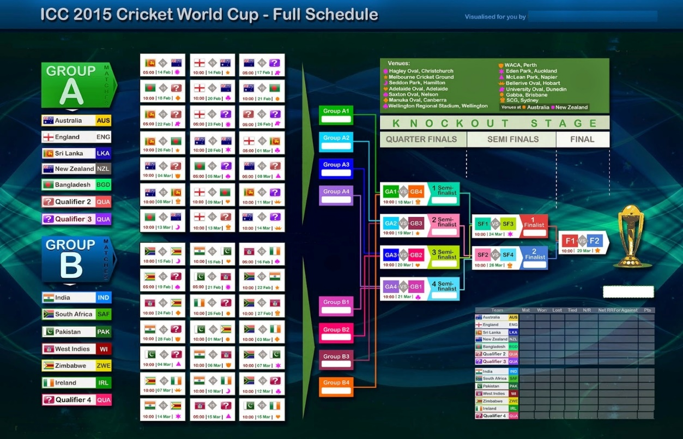
Problem Statement
We are interested in predicting the team standings at the commencement of world cup.

Slide 4
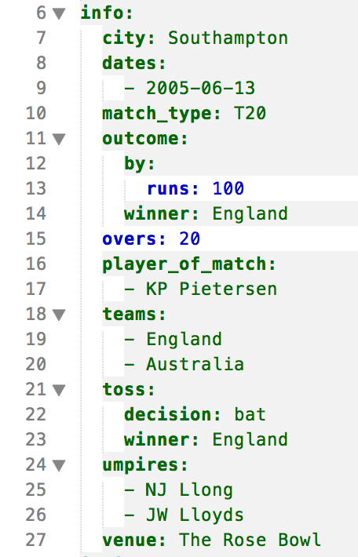
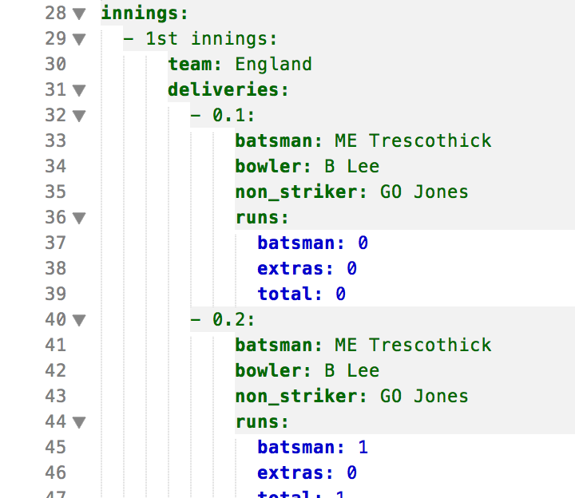
Introduction to Data Set
Total 1077 such files for ODI matches.

Slide 5
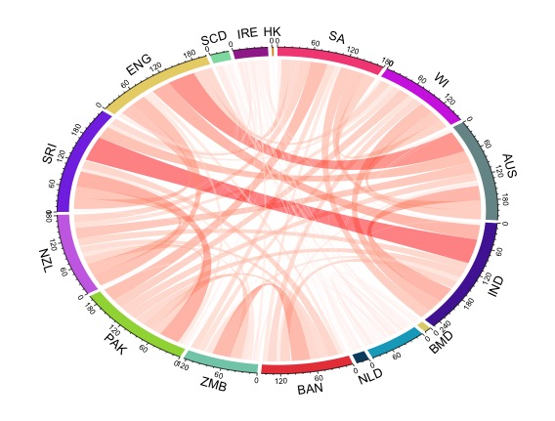
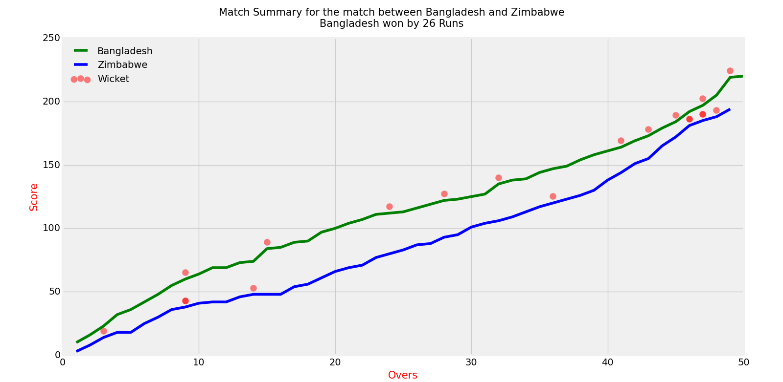
Initial Findings

Slide 6
Methodology
Classification Problem.
Decision Tree Classification
Random Forest Classification
Split into Train/Testing
Features Selection
Evaluation Model

Slide 7
Features
Home Ground Information
Team Names (One Hot Encoded)
Rankings
Points and Ratings
Team’s last win
Last Encounter
Venue Specific Performance
Example of one Hot encoding
Name | A1 | A2 | A3 | A4
Australia | 1 | 0 | 0 | 0
India | 0 | 1 | 0 | 0
Bangladesh | 0 | 0 | 1 | 0
Sri Lanka | 0 | 0 | 0 | 1

Slide 8
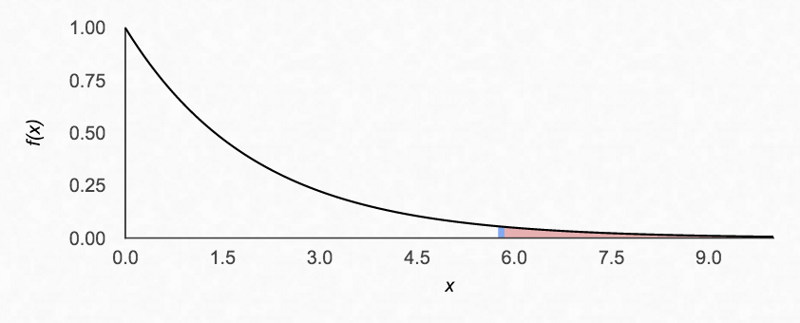
Home Ground Feature- Using Hypothesis Testing
Is Home Ground a Strong Feature ?
 | Home | Away | Total
Win | 21 | 80 | 101
Loss | 8 | 86 | 94
No Result | 1 | 5 | 6
Total | 30 | 171 | 201
Conduct a Pearson-Chi Squared Test (Also known as Goodness of fit test).
Construct a contingency table.
Calculate the Chi-squared statistic and compare it with the Chi-squared value at significance level of 5%.
Chi squared statistic, χ² = 5.798 for 2 degrees of freedom.
Critical Chi Squared value, χ² =4.605 for α = 0.05.

Slide 9
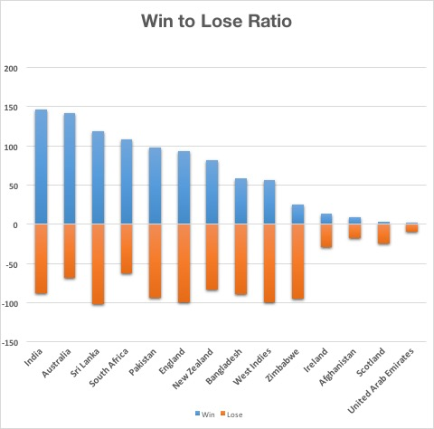
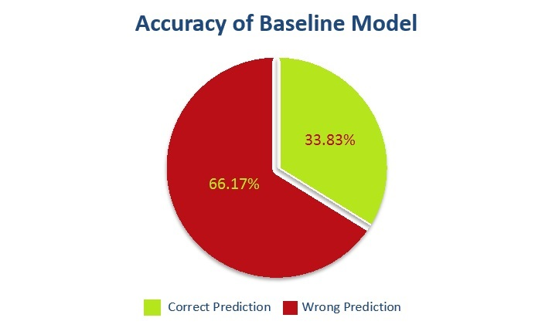
Base Line Model
Feature
Rank of Team A
Rank of Team B

Slide 10
Feature Selection- Decision Tree
B₁ and B₂
F₆
F₁
Training Score–
Model1 (=Baseline) → 0.3383
++ Points → 0.5259
++ Home Ground → 0.5089
++ Rating → 0.5111
++ Last Win → 0.5512
++ Venue Specific → 0.5454
++ Last Encounter → 0.5608
F₂
F₅
F₄
F₃
F₁
F₂
F₄
F₅
F₆

Slide 11
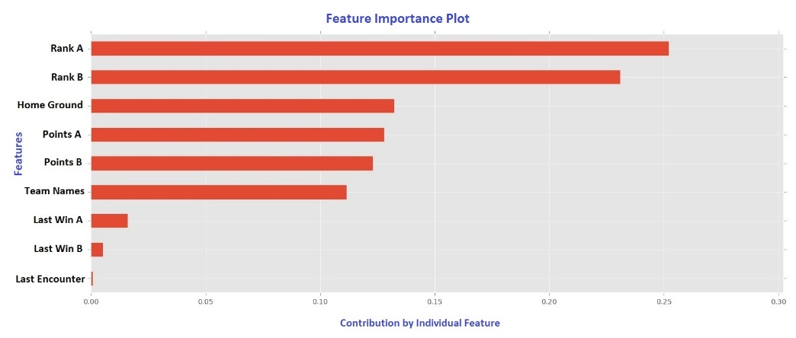
Changed Classifier to Random Forest
Training Scores → 0.6468
Percentage Improvement → 15%

Slide 12
Evaluation Model
Cross Validation with 3 folds.
Scores On | Score
Training | 0.6468
Testing | 0.6323
Cross Validation Score | 0.6281

Slide 13
Performance
Success Rate for League Matches:
Group A : 13/21
Group B : 14/21

Slide 14
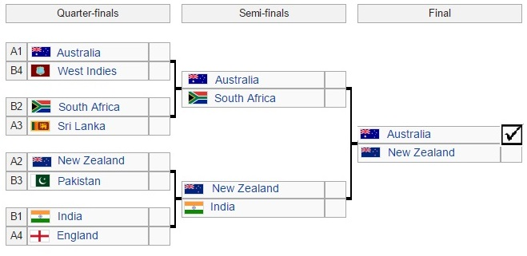
Performance contnd.
Our model estimated Sri-Lanka to reach Semi Finals.
Final four teams to reach semi finals are: Australia, Sri Lanka, India and New Zealand.
Models successfully predicts Australia and New Zealand to reach finals.

Slide 15
Conclusion
Rank | Team | Prediction
1 | Australia | Correct
2 | New Zealand | Correct
3 | India | Correct
4 | Sri Lanka | Incorrect
5 | South Africa | Incorrect
6 | Pakistan | Correct
7 | Bangladesh | Correct
8 | West Indies | Correct
9 | Ireland | Incorrect
10 | England | Incorrect
11 | Zimbabwe | Correct
12 | Afghanistan | Correct
13 | UAE | Correct
14 | Scotland | Correct
Our model could predict the rankings correctly for 10 teams.
Our prediction of 2015 world cup and the ground truth predicted 33 matches correctly out of 49 matches giving an accuracy of 67.34%.
This accuracy provides good betting odds and thus can make a bookie if not a millionaire hopefully richer. ☺

Slide 16
Thank you

